Slide 1
Part-1: Working with SparkSQL

Slide 2
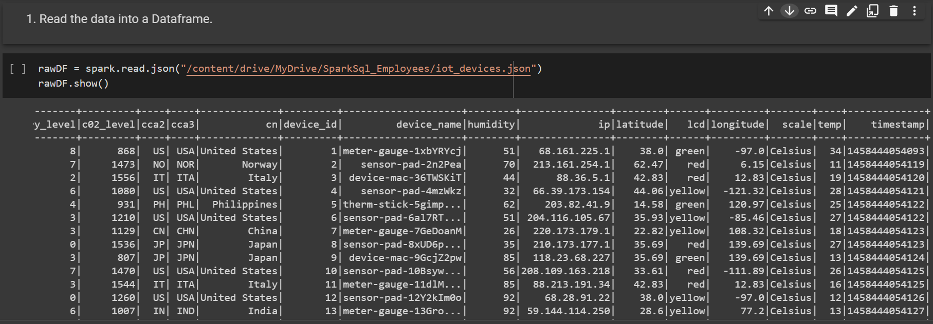

Slide 3

Convert the Dataframe into a temporary view called iot_devices.

Slide 4


Slide 5


Slide 6
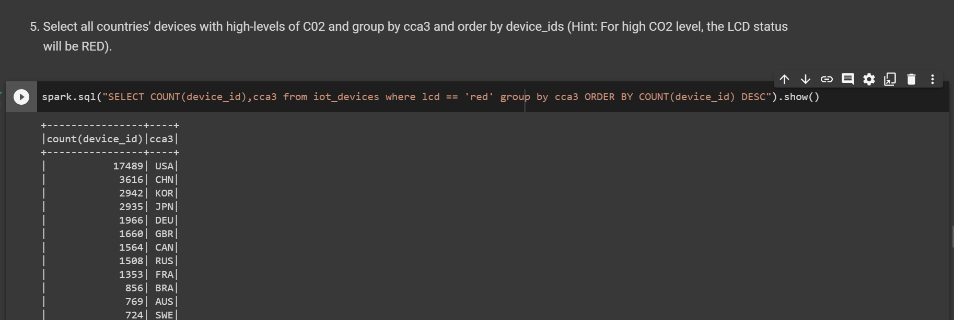

Slide 7



